Slide 1
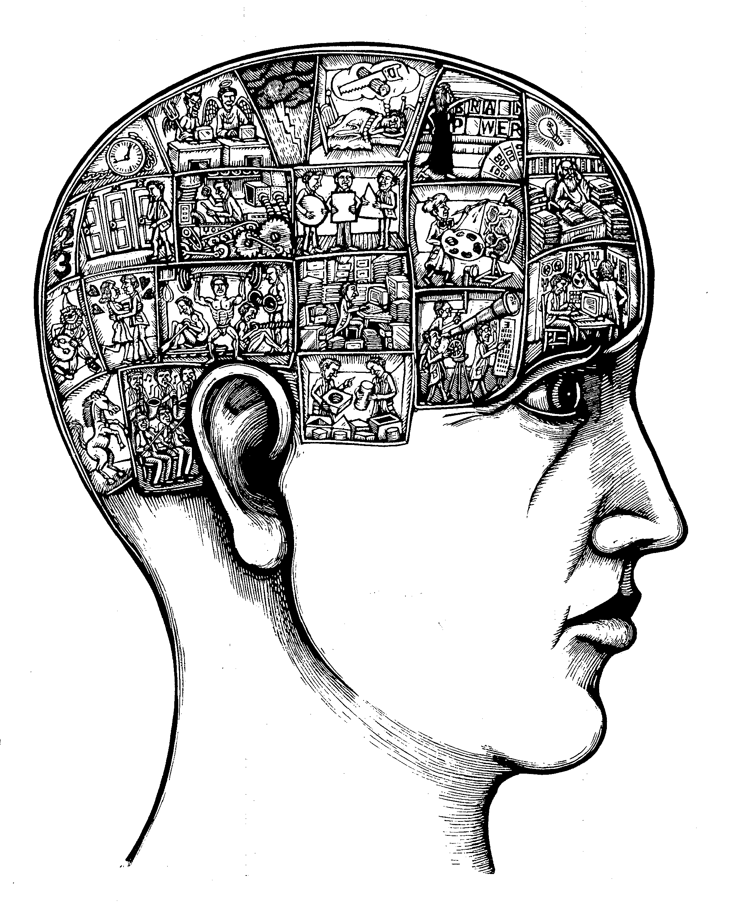
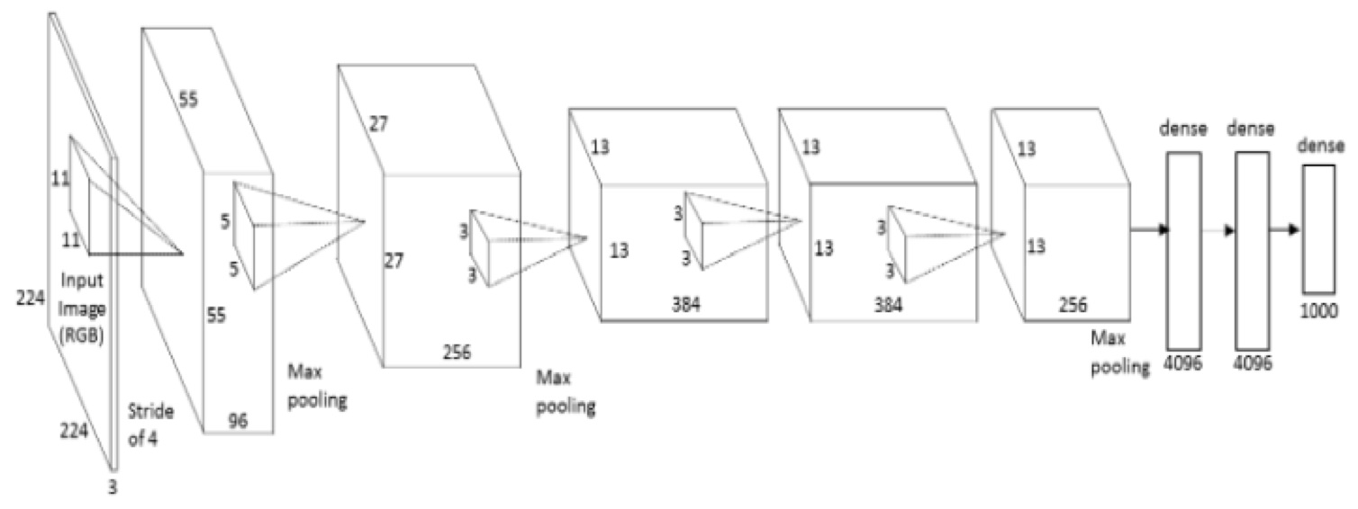
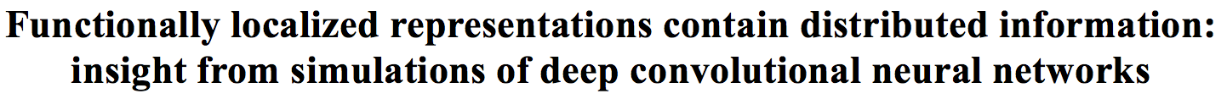
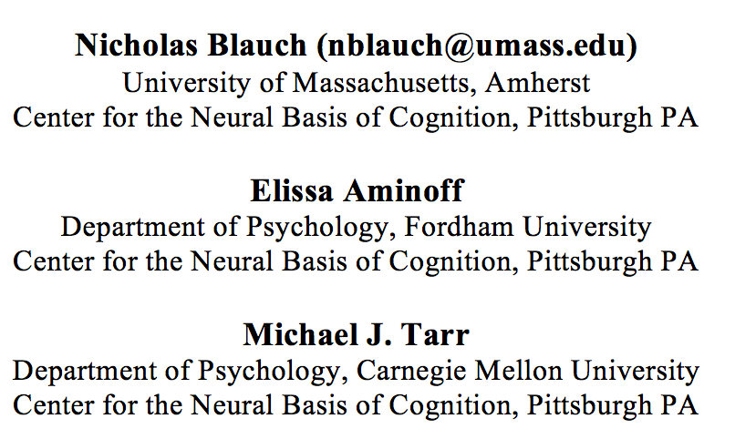
39th Annual Meeting of the Cognitive Science Society

Slide 2

Acknowledgments
Michael J. Tarr
Elissa Aminoff
Ying Yang
Rosie A. Cowell
David E. Huber

Slide 3
Big question for this talk Is the neural basis of face recognition distinct from that of general visual recognition?

Slide 4
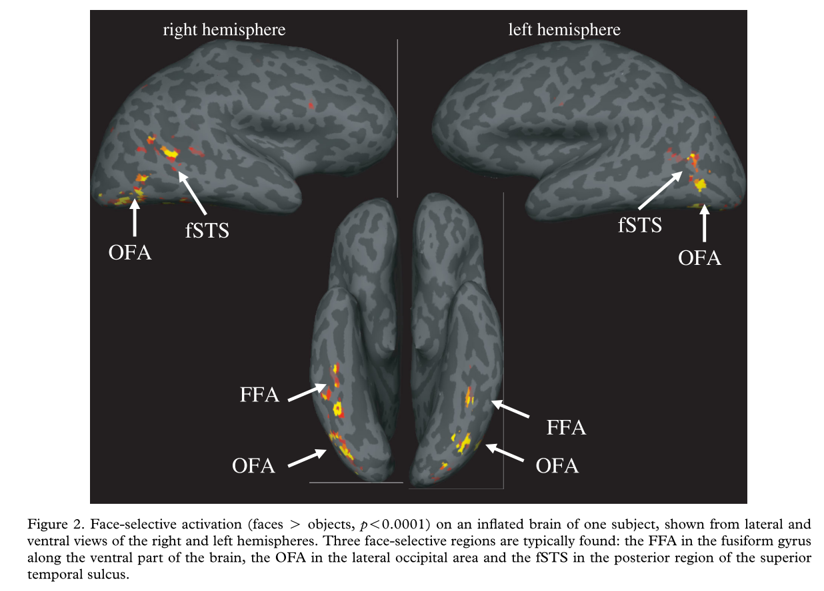
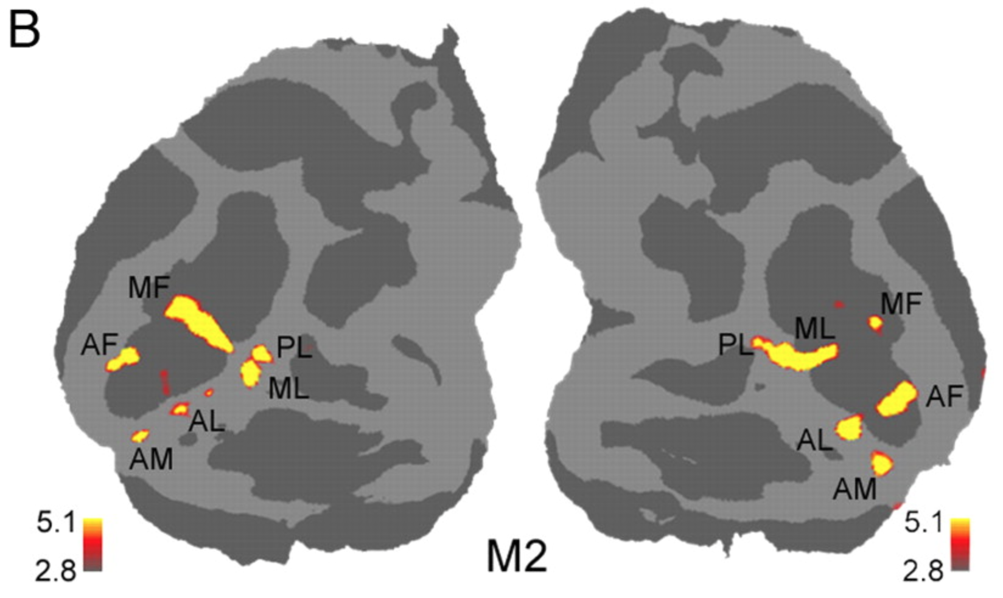
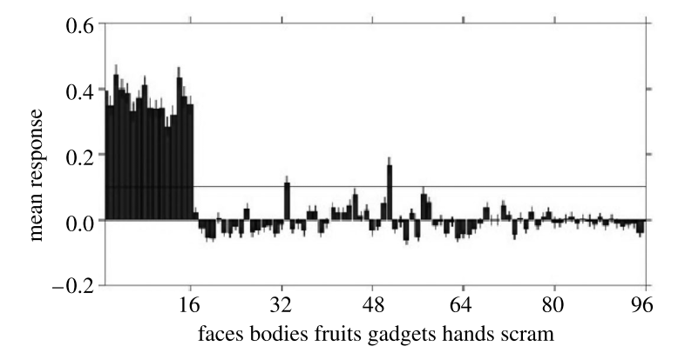
Functional localization of face processing
Human cortical regions selective to faces
(faces > objects, p<.00001)
Macaque monkey ”face patches” selective to faces vs. objects
Macaque face patches show enhanced mean neural response to faces
Kanwisher & Yovel, 2006
Tsao, Moeller, Freiwald 2008
Tsao,, Freiwald, Tootell & Livingstone, 2006
Face selectivity exists in stable locations in macaques as early as 200 days and overlaps with foveal and curvature selectivity present in the first postnatal weeks (Livingstone et. al, 2017; Arcaro & Livingstone, 2017)
Face selectivity seems to be driven by low-level features and refined by perceptual experience recognizing faces
Tracer injections in face patches reveal greater connectivity with each other than than other nearby regions (Grimaldi, Saleem, Tsao, 2016)
-> functional sub-hierarchy honed by evolution?

Slide 5
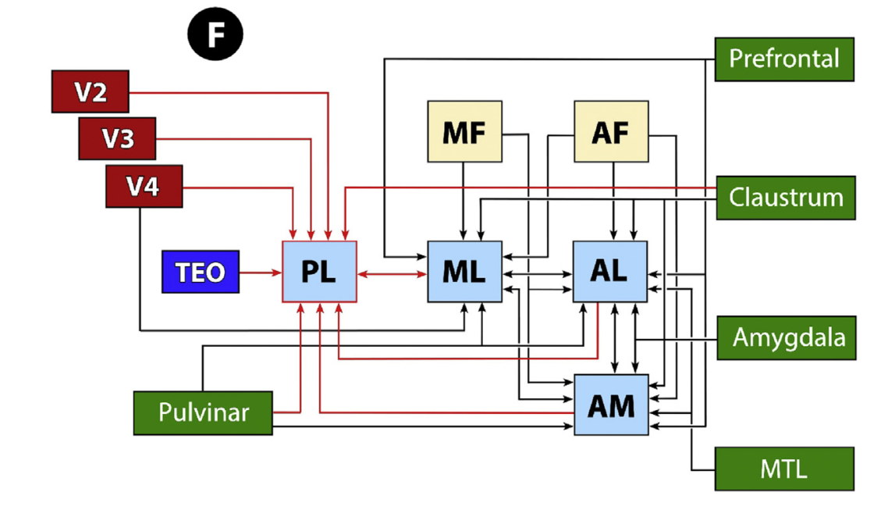
Proposed wiring diagram of a functional sub-hierarchy for face processing
Grimaldi, Saleem, Tsao (2016)

Slide 6
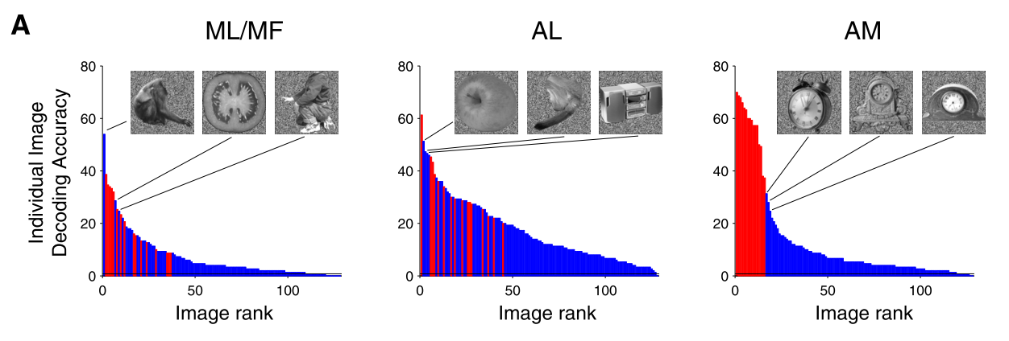
Are face-selective regions just part of a distributed code?
Multivariate pattern analysis (MVPA) of human face-selective areas supports non-face discrimination, and MVPA can discriminate faces without face-selective areas (Haxby et. al, 2001)
MVPA of all macaque “face patches” supports discrimination of most non-face images (Meyers et. al, 2015)
However, there are clear advantages for faces, especially in the most anterior patch AM
Seems unlikely that processing in face selective areas is a full-fledged module gated by earlier face-detection (e.g. Tsao & Livingstone, 2008)
Preferences in mean firing rate and information suggest a form of un-gated “specialization” or marginal “modularity”
face
Non-face
Meyers et. al, 2015
Notes:
In preliminary re-analyses of this data (originally collected in Freiwald & Tsao, 2010), we find no correlation between activation of face-detection mechanisms and information or mean activation in the face patches. Hoping to show that work at CCN in September.

Slide 7
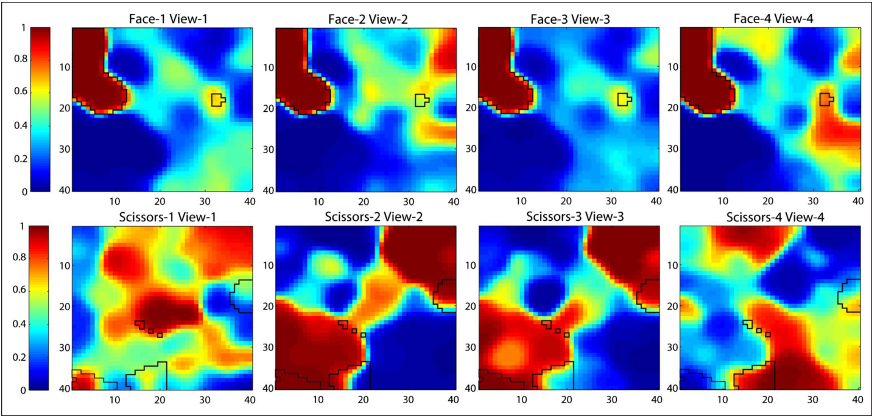
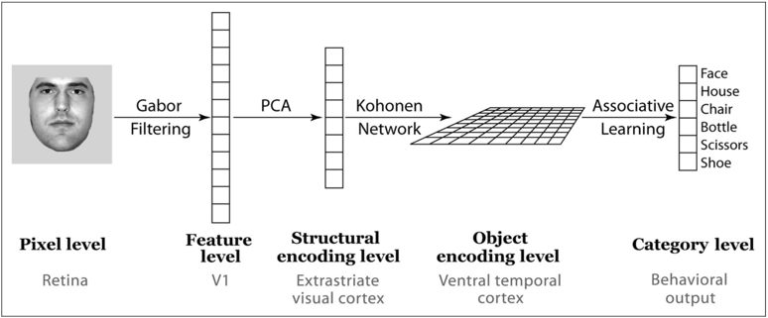
A model of distributed representation produces face-selectivity
Visual representations stored in a domain-general self-organizing Kohonen grid naturally develop strong view-independent face preferences compared to other categories (Cowell & Cottrell, 2013)
However this model cannot perform face individuation – all individuals look basically the same!
Not constraining to individuation belies the need for specialized circuitry for faces above other object categories for which individuation is less important
Cowell & Cottrell, 2013

Slide 8
Deep convolutional neural networks can perform human-level object recognition and face individuation
“Alexnet” – from Krizhevsky, A., Sutskever, I., & Hinton, G. E. (2012).
Do functionally localized DCNN representations yield category-distributed information?

Slide 9
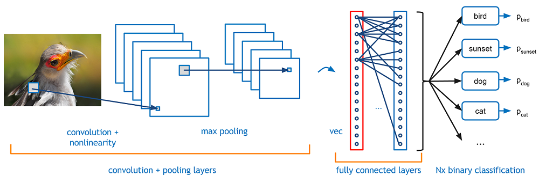
Deep convolutional neural networks for visual categorization
DCNNs are the state-of-the-art in computer vision applications relating to high-level visual knowledge, such as categorization
They consist of a hierarchy of processing layers and learn features through training on millions of images
DCNN representations provide the best fits of neural data related to object recognition (Yamins et. al, 2014; Güclü & van Gervan, 2015)
Impressive behavioral achievements, biological-inspiration, and ability to predict neural responses make them a powerful class of models for cognitive science
Graphic provided by Adit Deshpande’s guide to understanding CNNs
https://adeshpande3.github.io/adeshpande3.github.io/A-Beginner%27s-Guide-To-Understanding-Convolutional-Neural-Networks/

Slide 10

Deep convolutional neural networks for visual categorization
How much information do localized categorical representations contain about other categories?
Graphic provided by Adit Deshpande’s guide to understanding CNNs
https://adeshpande3.github.io/adeshpande3.github.io/A-Beginner%27s-Guide-To-Understanding-Convolutional-Neural-Networks/

Slide 11
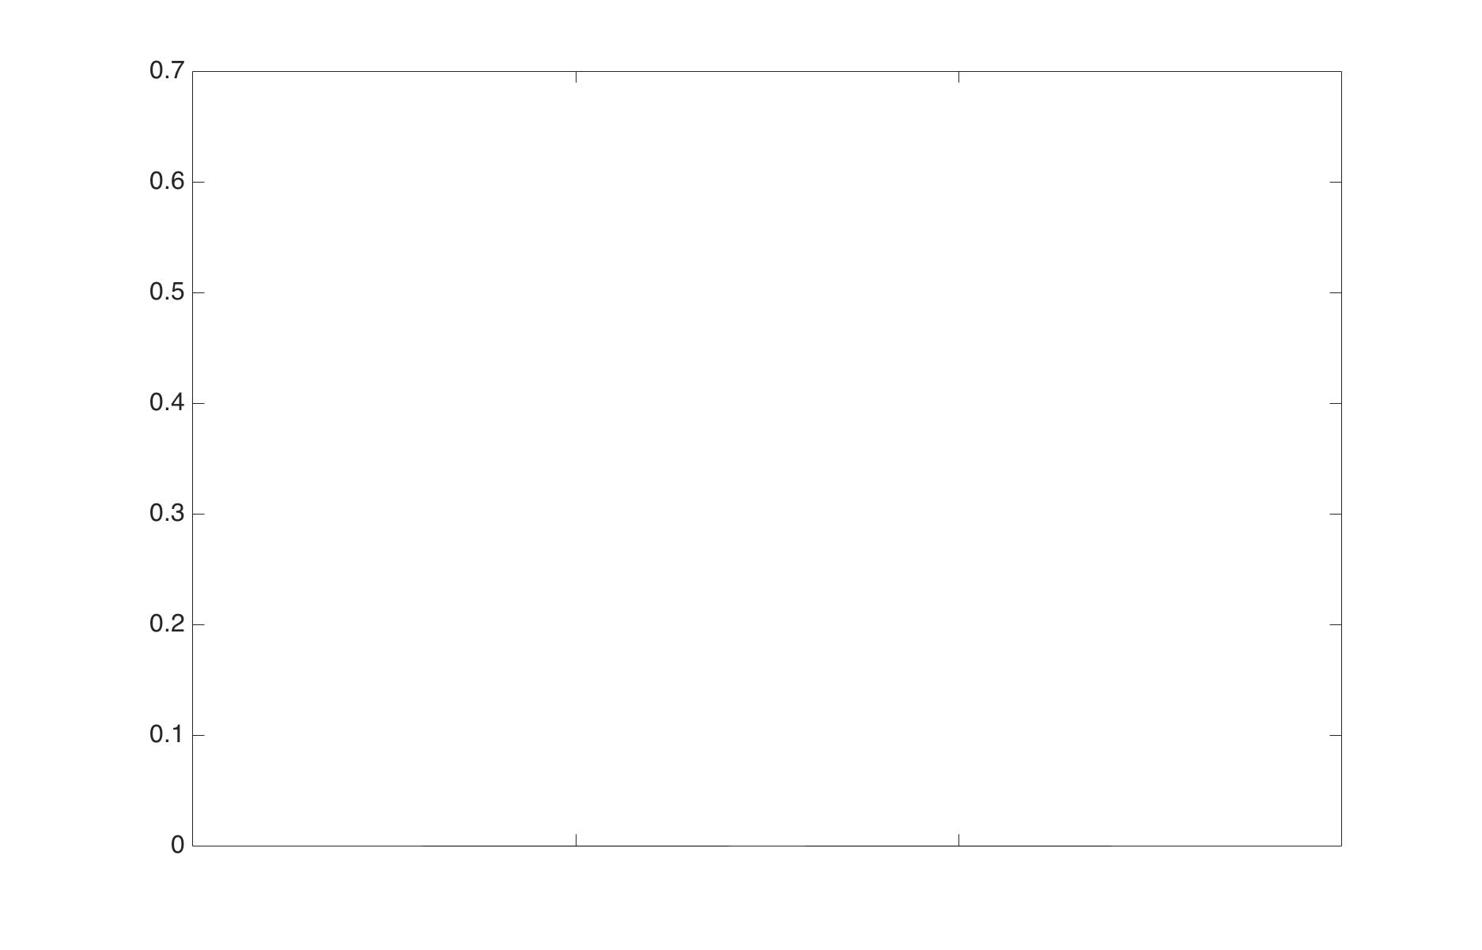
Results: decoding single-unit localized categorical representations in Alexnet
Using 10-fold (80% training) cross-validated SVM classification with bootstrapped pairs across a sample of 20 ImageNet categories
Accuracy
Blauch, Aminoff, Tarr (2017)
Explicitly represented
vs. not
Not explicitly represented
2-way discrimination task

Slide 12
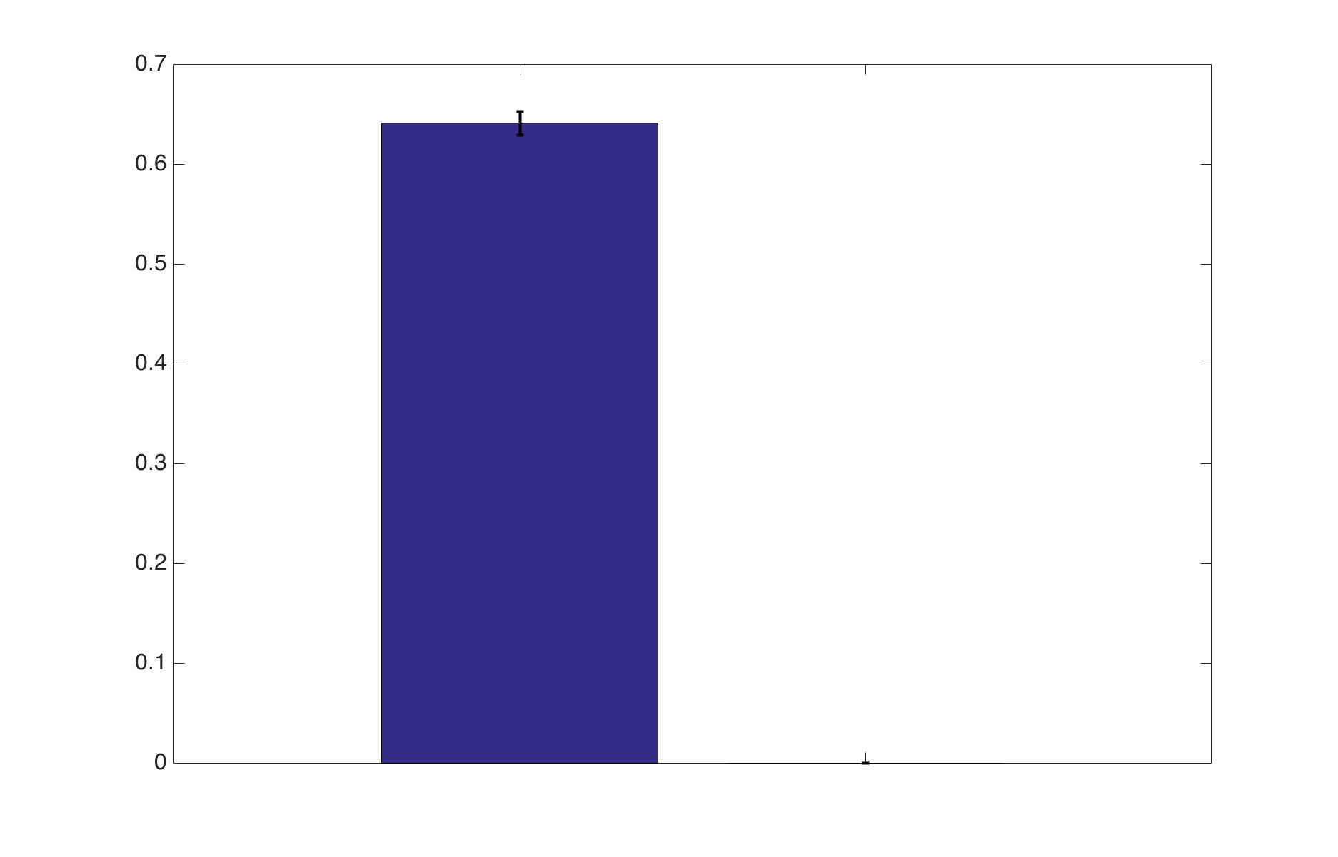
Results: decoding single-unit localized categorical representations in Alexnet
Using 10-fold (80% training) cross-validated SVM classification with bootstrapped pairs across a sample of 20 ImageNet categories
Accuracy
Blauch, Aminoff, Tarr (2017)
Explicitly represented
vs. not
Not explicitly represented
2-way discrimination task

Slide 13
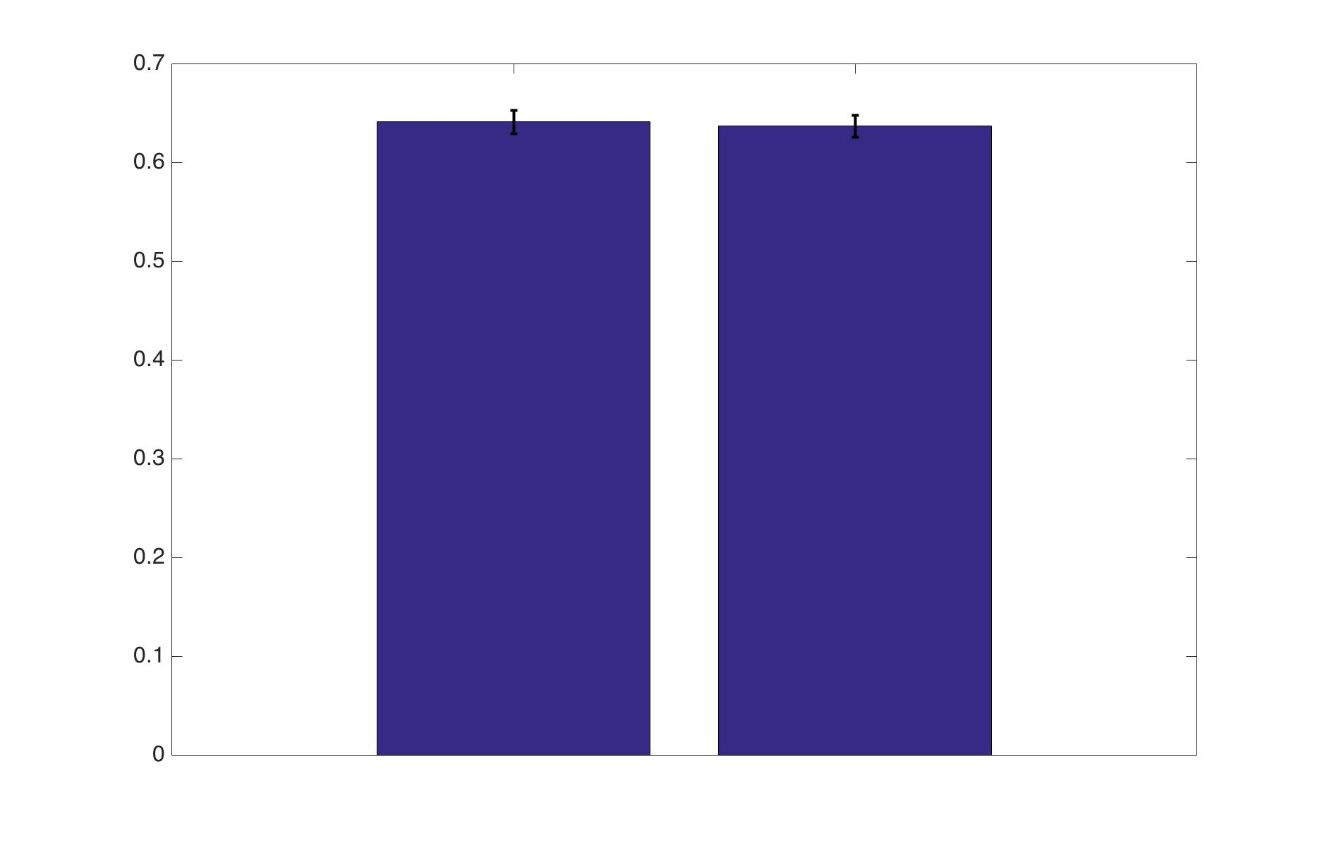
Results: decoding single-unit localized categorical representations in Alexnet
Using 10-fold (80% training) cross-validated SVM classification with bootstrapped pairs across a sample of 20 ImageNet categories
Accuracy
Blauch, Aminoff, Tarr (2017)
Explicitly represented
vs. not
Not explicitly represented
2-way discrimination task
Notes:
Conclusion Localized categorical representations are equally capable of discriminating between non-explicitly represented categories as between their explicitly represented category and another

Slide 14
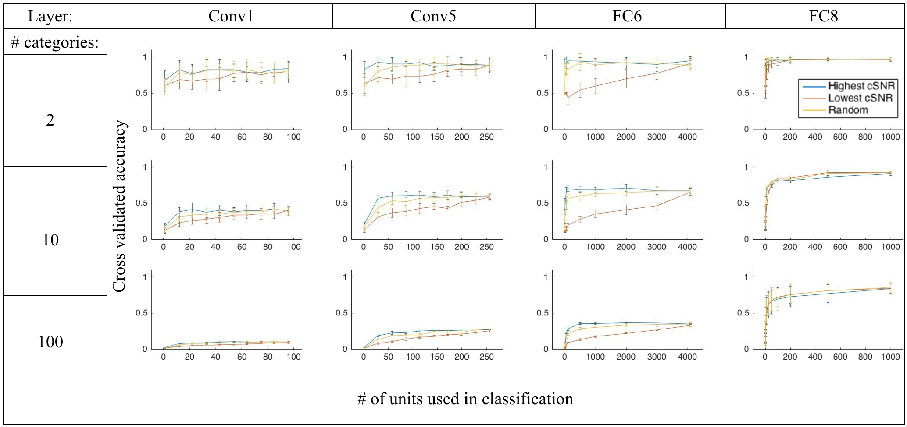
Decoding populations of units across layers in Alexnet
Blauch, Aminoff, Tarr (2017)
Notes:
Categorical units can be highly discriminative of non-represented categories!

Slide 15
DCNNs for face individuation
Person 1
pperson1
Person 2
pperson2
Person 3
pperson3
Person 4
pperson4
VGG-face is a state-of-the-art DCNN for face individuation, trained to individuate 2622 faces at >90% accuracy (Parki, Vedaldi, and Zimmerman, 2015)
The last fully-connected layer contains 4096 high-level features trained specifically for face individuation
We use these representations as a model of high-level face-specialized representations, e.g. a “modular” hypothesis about FFA or face patch AL
A computational face “module”
4096 nodes
…
DCNN architecture cartoon adapted from Adit Deshpande’s guide to understanding CNNs
https://adeshpande3.github.io/adeshpande3.github.io/A-Beginner%27s-Guide-To-Understanding-Convolutional-Neural-Networks/

Slide 16
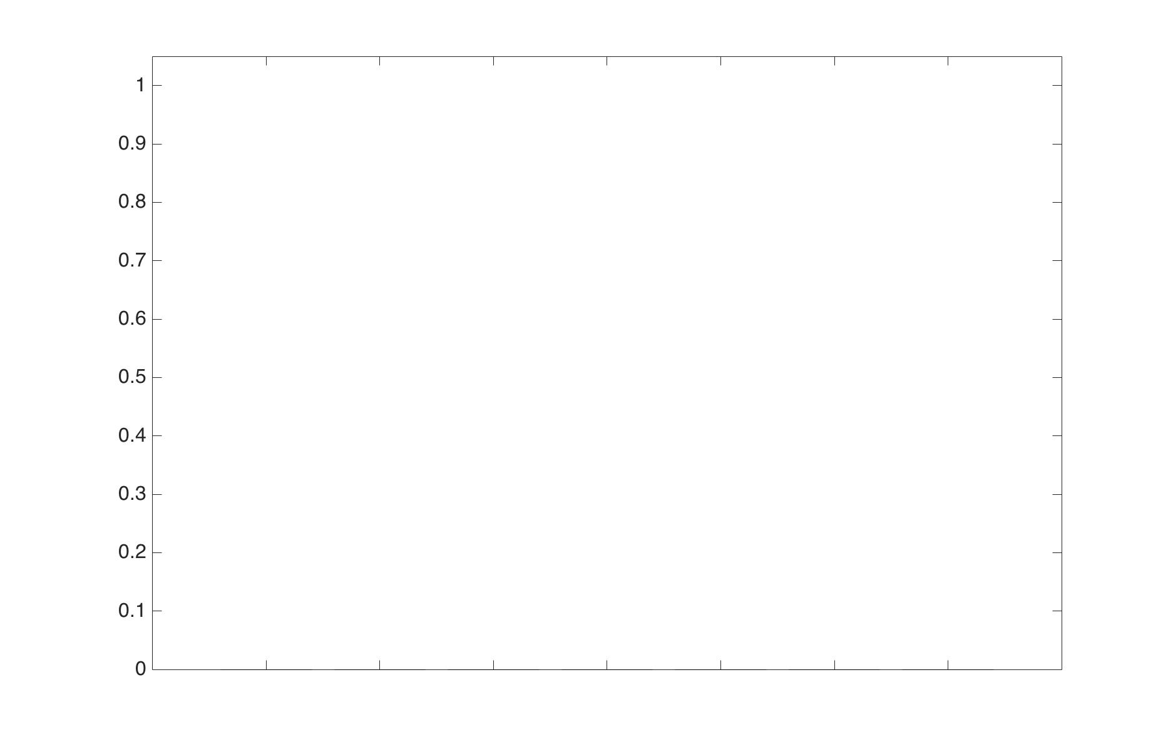
Results: decoding a computational face module
Using 10-fold (80% training) cross-validated SVM classification
Accuracy
Blauch, Aminoff, Tarr (2017)
Face
vs.
Scene
Face
vs.
Object
Face
vs.
Body Part
Scene
vs.
Body Part
Scene
vs.
Object
Object
vs.
Body Part
ImageNet category 1
vs.
Imagenet category 2
2-way discrimination task

Slide 17
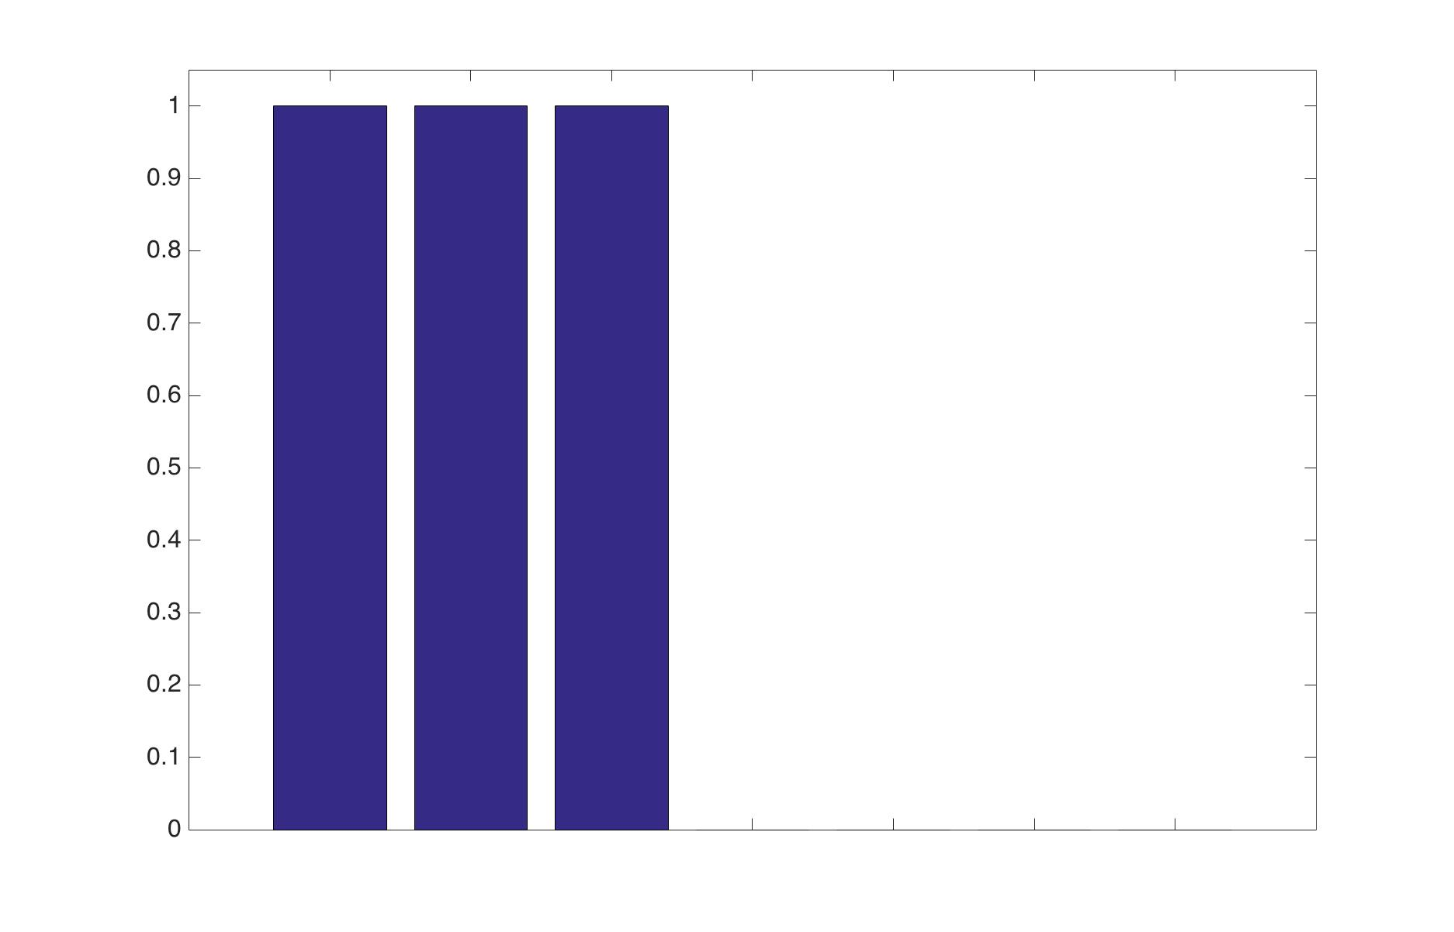
Results: decoding a computational face module
Using 10-fold (80% training) cross-validated SVM classification
Accuracy
Blauch, Aminoff, Tarr (2017)
Face
vs.
Scene
Face
vs.
Object
Face
vs.
Body Part
Scene
vs.
Body Part
Scene
vs.
Object
Object
vs.
Body Part
ImageNet category 1
vs.
Imagenet category 2
2-way discrimination task

Slide 18
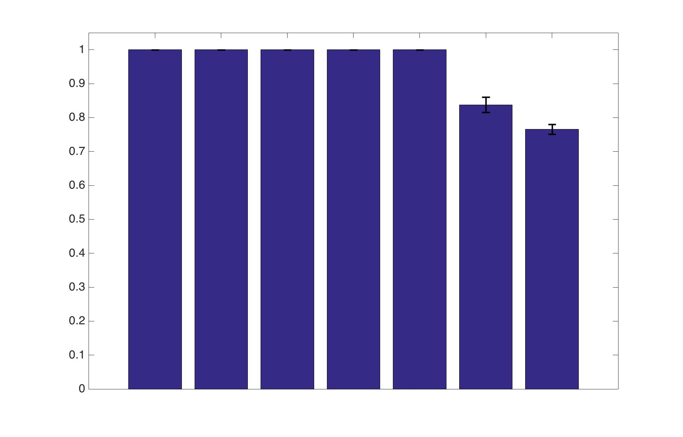
Results: decoding a computational face module
Using 10-fold (80% training) cross-validated SVM classification
Accuracy
Blauch, Aminoff, Tarr (2017)
Face
vs.
Scene
Face
vs.
Object
Face
vs.
Body Part
Scene
vs.
Body Part
Scene
vs.
Object
Object
vs.
Body Part
ImageNet category 1
vs.
Imagenet category 2
2-way discrimination task
Notes:
Conclusion Activations in a DCNN trained only for face individuation are sufficient for non-face categorical discrimination

Slide 19
Conclusions
The brain is highly selective for visual faces (e.g. Kanwisher & Yovel, 2006)
Face-selective areas seem to still process non-face inputs (Haxby et. al, 2001; Meyers et. al, 2015)
A distributed topographic representation produces the characteristic evidence of functionally localized activation (Cowell & Cottrell, 2013) but is shallow and cannot perform face individuation
We show that deep functionally localized representations sufficient for human-level object categorization and face individuation produce categorically distributed information
Information can be deceiving! Information != function. Must build models to get at function.
Current neuroscience evidence is thus consistent with both distributed and localized processing of faces
Due to behavioral requirements and stimulus properties, we suspect that the true face processing scheme is moderately modular – containing patches highly specialized/trained for faces but not formally gated and thus adaptable to visual experience

Slide 20
Discussion: the origins of functional localization of face processing
Self-organizing principles lead to face-selectivity based on within-category feature similarity alone (Cowell & Cottrell, 2013)
Innate face looking preference (e.g. Johnson et. al, 1991; Reid et. al, 2017) creates input bias, causing greater tuning to faces. This preference may be mediated by innate subcortical circuitry (Johnson, 2005).
Regularization over connection length leads to greater modularization (Clune, Mouret, Lipson, 2013)
Expertise with individuating faces causes top-down refinement of face-selective circuitry (e.g. Tarr & Gauthier, 2000)
Could be the basis of face specialization, or face-specialization could be the basis of other categories of expertise eliciting high activation in FFA (e.g. birds, greebles, cars)
Finer-grained representations developed for face recognition may be usefully coopted for other face-like categories requiring expertise
Next steps – build models to test the behavioral and “neuroscientific” effects of these various factors

Slide 21
References
Krizhevsky, A., Sutskever, I., & Hinton, G. E. (2012). ImageNet Classification with Deep Convolutional Neural Networks. Advances In Neural Information Processing Systems, 1–9. https://doi.org/http://dx.doi.org/10.1016/j.protcy.2014.09.007
Spiridon, M., & Kanwisher, N. (2002). How distributed is visual category information in human occipito-temporal cortex? An fMRI study. Neuron, 35(6), 1157–1165. https://doi.org/10.1016/S0896-6273(02)00877-2
Haxby, J. V, Gobbini, M. I., Furey, M. L., Ishai, A., Schouten, J. L., & Pietrini, P. (2001). Distributed and overlapping representations of faces and objects in ventral temporal cortex. Science, 293(September), 2425–2430. https://doi.org/10.1126/science.1063736
Kanwisher, N., McDermott, J., & Chun, M. M. (1997). The fusiform face area: a module in human extrastriate cortex specialized for face perception. The Journal of Neuroscience : The Official Journal of the Society for Neuroscience, 17(11), 4302–11. https://doi.org/10.1098/Rstb.2006.1934
Vedaldi, A., & Lenc, K. (2015). MatConvNet. Proceedings of the 23rd ACM International Conference on Multimedia - MM ’15, 689–692. https://doi.org/10.1145/2733373.2807412
Nguyen, M. N., Nishimaru, H., Matsumoto, J., Le, Q. Van, & Hori, E. (2016). Population Coding of Facial Information in the Monkey Superior Colliculus and Pulvinar, 10(December). https://doi.org/10.3389/fnins.2016.00583
Grimaldi, P., Saleem, K. S., Tsao, D., Grimaldi, P., Saleem, K. S., & Tsao, D. (2016). Anatomical Connections of the Functionally Defined “‘ Face Patches ’” in the Macaque Monkey Article Anatomical Connections of the Functionally Defined “‘ Face Patches ’” in the Macaque Monkey. Neuron, 90(6), 1325–1342. https://doi.org/10.1016/j.neuron.2016.05.009
Chang, L., & Tsao, D. Y. (2017). The Code for Facial Identity in the Primate Brain. Cell, 169(6), 1013–1020.e14. https://doi.org/10.1016/j.cell.2017.05.011
Meyers, E. M., Borzello, M., Freiwald, W. A., & Tsao, D. (2015). Intelligent Information Loss: The Coding of Facial Identity, Head Pose, and Non-Face Information in the Macaque Face Patch System. Journal of Neuroscience, 35(18), 7069–7081. https://doi.org/10.1523/JNEUROSCI.3086-14.2015
Hanson, S. J., & Schmidt, A. (2011). High-resolution imaging of the fusiform face area (FFA) using multivariate non-linear classifiers shows diagnosticity for non-face categories. NeuroImage, 54(2), 1715–1734. https://doi.org/10.1016/j.neuroimage.2010.08.028
Kanwisher, N. (2010). Functional specificity in the human brain: a window into the functional architecture of the mind. Proceedings of the National Academy of Sciences of the United States of America, 107(25), 11163–11170. https://doi.org/10.1073/pnas.1005062107
Tsao, D. Y., & Livingstone, M. S. (2008). Mechanisms of Face Perception. Annual Reviews Neuroscience, 31, 411–37. https://doi.org/10.1146/annurev.neuro.30.051606.094238
Chang, L., & Tsao, D. Y. (2017). The Code for Facial Identity in the Primate Brain. Cell, 169(6), 1013–1020.e14. https://doi.org/10.1016/j.cell.2017.05.011
Grimaldi, P., Saleem, K. S., & Tsao, D. (2016). Anatomical Connections of the Functionally Defined “‘ Face Patches ’” in the Macaque Monkey. Neuron, 90(6), 1325–1342. https://doi.org/10.1016/j.neuron.2016.05.009
Meyers, E. M., Borzello, M., Freiwald, W. A., & Tsao, D. (2015). Intelligent Information Loss: The Coding of Facial Identity, Head Pose, and Non-Face Information in the Macaque Face Patch System. Journal of Neuroscience, 35(18), 7069–7081. https://doi.org/10.1523/JNEUROSCI.3086-14.2015
Gauthier, I. (2017). The Quest for the FFA led to the Expertise Account of its Specialization. Arxiv.org
Johnson, M. H., Dziurawiec, S., Ellis, H., & Morton, J. (1991). Newborns’ preferential tracking of face-like stimuli and its subsequent decline. Cognition, 40(1–2), 1–19. https://doi.org/10.1016/0010-0277(91)90045-6
Reid, V. M., Dunn, K., Young, R. J., Amu, J., Donovan, T., Reissland, N. (2017). The Human Fetus Preferentially Engages with Face-like Visual Stimuli. Current Biology, 27(12), 1825–1828.e3. https://doi.org/10.1016/j.cub.2017.05.044
Adit Deshpande’s GitHub: A Beginner's Guide To Understanding Convolutional Neural Networks https://adeshpande3.github.io/adeshpande3.github.io/A-Beginner%27s-Guide-To-Understanding-Convolutional-Neural-Networks

Slide 22
Thanks! Questions?

